Slide 1
Data Structures Notes
Terry Sergeant

Slide 2
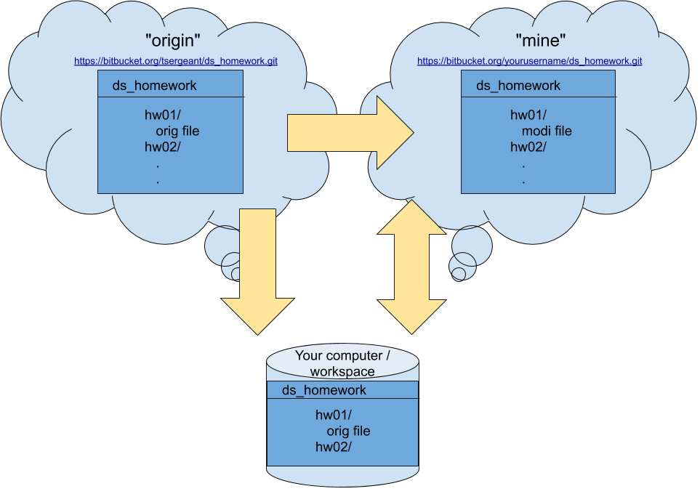
Git Architecture for this Course

Slide 3

A Linked List of Dictionary Words and Their Pronunciations

Slide 4
Algorithms
In computer science an algorithm is typically defined as a "series of steps to solve a problem that will finish in a finite number of steps."
algorithms exist in a variety of human endeavors and are expressed in a language appropriate to the discipline
e.g., recipes are algorithms for cooking; playbooks are algorithms for a sport; etc.
In computer science algorithms are typically expressed using a flow chart or using pseudocode
NOTE: We will use pseudocode to express algorithms in this course. Pseudocode is not a particular language, but is written in such a way as to be language-neutral and understood by other computer scientists.
Q: What is the difference between an algorithm and a program?
A: A program is written in a specific language known to a computer and as such is an implementation of an algorithm.

Slide 5
Measuring Algorithm Complexity
Algorithm Analysis vs. Program Analysis
We are typically interested in one of these:
Space complexity = i.e., how much memory (working space) does an algorithm require
Time complexity = how many steps must be performed before the algorithm completes
In this course will will focus primarily on time complexity.
Algorithm Analysis | Program Analysis
Uses an analytical model (Random Access Machine) | Uses a computer
Time is measure in steps | Times is measured by a clock
Worst-case analysis | Specific-case analysis
Classify algorithms asymptotically | Classify program by comparing run-times

Slide 6
An Example of Asymptotic Analysis
Problem: Given a positive integer n as input will calculate this sum: 1 + 2 + ... + n
The most obvious approach to this problem is to write a loop to calculate the sum. NOTE: This particular series has a closed form, but for now let's stick with the loop concept.
Exercise: Write an algorithm (using pseudocode) to solve this problem.

Slide 7
One Solution to 1 + 2 + ... + n
Here's one approach:
read n
sum = 0
for i = 1 to n do
sum = sum + i
endfor
print sum
To analyze the complexity of our solution we need to count how many steps. In this case, the number of steps clearly depends on the input (n). So let's count ...
There are two statements before the loop and one after so that's 3 steps.
Inside the for loop we add i to the variable sum n total times, so that is n steps.
The for-loop itself actually does a good bit of work. We have to evaluate it n+1 times (so we know it is time to stop) and you could argue that it does multiple things (comparison, adding one to a counter, etc.) For now, let's just count it as n+1 steps. So our total number of steps is: 2n+4.

Slide 8
The Complexity of Our Algorithm
So, in one interpretation we have our solution to 1 + 2 + ... + n as requiring 2n+4. If we insist that the for loop does a compare, a branch, and adds one to a variable then you can add 2(n+1) to that giving a 4n+5 number of steps.
Or, if we evaluate the algorithm in assembly language we can get a more accurate count of the actual steps being performed ....
So, what is "the answer"?
In this particular case we don't really care whether it is 2n+4 or 4n+5 because those are both considered to be the "same" when we do "asymptotic" analysis which asks the question: "What happens when n get really, really big?"
When n gets huge the +5 vs +2 doesn't really matter much ... and even the 4n vs 2n seems to fade in significance in the light of the enormous value of n. We say that n is the dominant term and we express our answer using "big-oh" notation:
O(n)

Slide 9
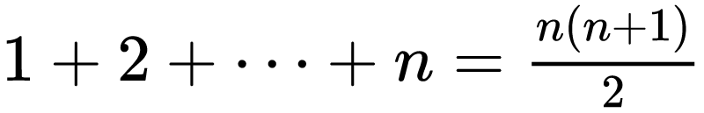
What is "Big-Oh"
This mysterious big-oh function has a precise mathematical definition which we'll investigate later, but for now just know that when we apply it, it will strip away constants and lower order terms and leave us with simply the dominant term!
Let's take advantage of the fact that there is a closed form for the series: 1 + 2 + ... + n. In particular:
So, another algorithm to solve this problem might be this:
read n
sum = n * (n + 1) / 2
print sum
When we analyze the complexity of this formula we might count this a 3 steps. Or you might argue that the calculation actually involves 3 operation plus storing a value so it might count as 4 steps on its own and the other two added gives us 6 steps.

Slide 10
3 Step vs. 6 Steps
So, how does asymptotic analysis handle the 3 step vs. 6 step conundrum?
Notice that whether 3 steps or 6 steps, the number of steps is no longer dependent on the input! We call such an algorithm "constant time" and we express it using big-oh as:
O(1)

Slide 11
What is "Worst-Case" Analysis?
Consider this algorithm:
sum = 0
i = 0
repeat
read a
read b
i = i + 1
sum = sum + a - b
until i==n or a<b
Exercise: What is the complexity of this algorithm? Count the number of steps and then use big-oh to strip away constants and lower-order terms.

Slide 12
Worst Case Analysis (Solution)
As we walk through the algorithm we see there is a loop. When we try to determine how many times the loop occurs we encounter a situation in which the answer is "it depends". There are two conditions that might end the loop:
We might end after n iterations when i eventually reaches n.
We might end sooner than that in the case that the input we retrieve in a loop iteration may result in a being less than b.
There is no way to know ahead of time when the loop will end.
In a situation of uncertainty such as this we typically perform "worst-case" analysis. That is, we assume that inputs will come in such as way as to extend our algorithm as long as possible!
So, I might count the steps like this: 2 before the loop, 5 steps inside a loop that in the worst-case will happen n times which gives us 5n+2 steps or:
O(n)

Slide 13
Exercise: Analyze the Complexity
Exercise: Using worst-case, asymptotic analysis, determine the complexity of this algorithm assuming a[] is an array (index 1 to n) of n numbers:
for i = 1 to n - 1 do
for j = i + 1 to n do
if a[i] > a[j] then
temp= a[i]
a[i]= a[j]
a[j]= temp
endif
endfor
endfor
NOTE: This is a "selection sort" algorithm. One challenge is that we have a loop inside of a loop and the number of times the inner loop happens changes for each iteration of the outer loop!
Have fun!

Slide 14
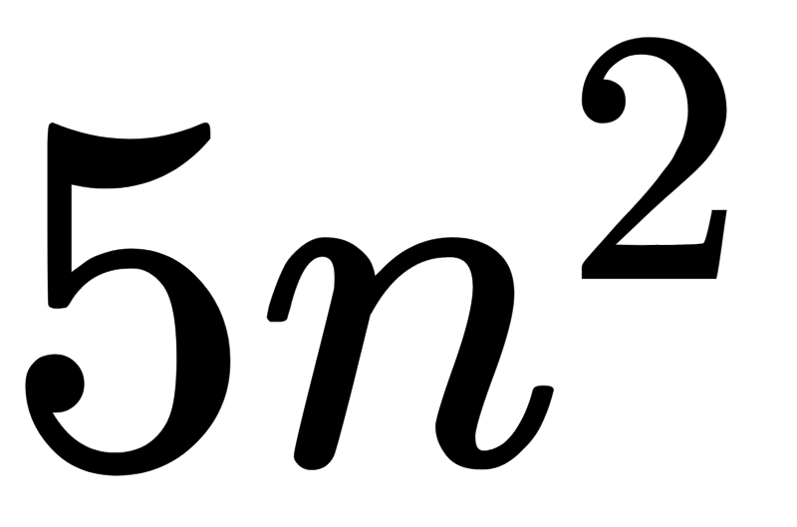
Solution to Analysis of Selection Sort (Part 1)
Sometimes it can be helpful to get started on a problem by simplifying it. Let's slight modify the original algorithm and analyze the simpler version first:
for i = 1 to n do
for j = 1 to n do
if a[i] > a[j] then
temp= a[i]
a[i]= a[j]
a[j]= temp
endif
endfor
endfor
In this case I've modified the inner and outer loop each to happen exactly n times. Now counting steps is a bit easier:
for each time through the outer loop we do 5n steps for the inner loop (in worst-case the if is always true)
the outer loop happens n times
so the total number of steps is

Slide 15
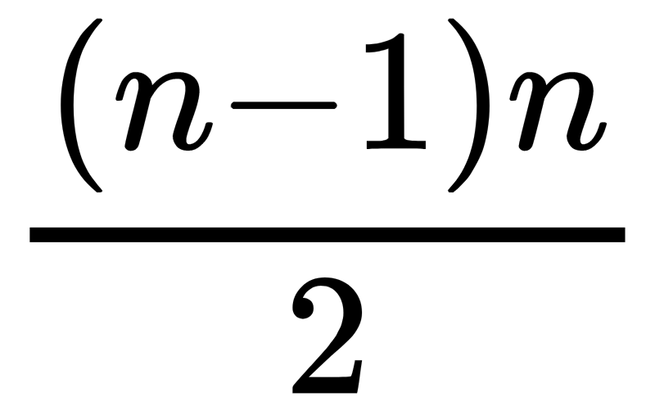
Solution to Analysis of Selection Sort (Part 2)
Going back to the original algorithm there are a couple of notable changes:
for i = 1 to n - 1 do
for j = i + 1 to n do
if a[i] > a[j] then
temp= a[i]
a[i]= a[j]
a[j]= temp
endif
endfor
endfor
The outer loop only happens n-1 times
The inner loop initially happens n-1 times, then when it starts again it happens n-2 times; the next time is happens n-3 times, etc.
On the last time through the inner loop i is n-1 so the inner loop only happens once.
So, if we add up the number of times the inner loop happens we get: 1 + 2 + 3 ... + (n-3) + (n-2) + (n-1).
When we plug that into our handy closed form we get:

Slide 16

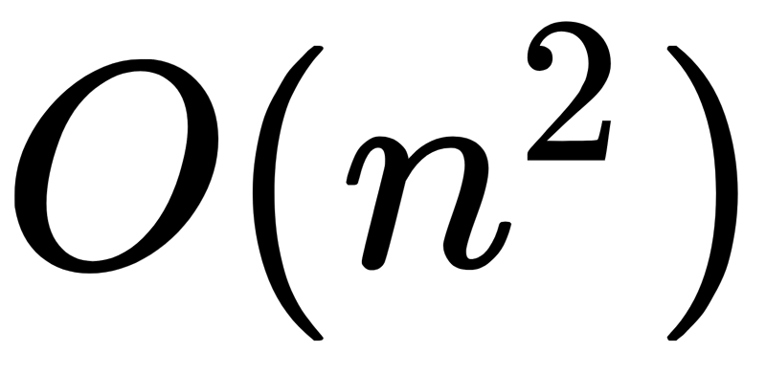
Solution to Analysis of Selection Sort (Part 3)
But it is actually that number times 5 plus the n-1 steps of the outer loop yielding:
When we apply big-oh the n^2 terms dominates the expression leaving us with:

Slide 17
Priority Queues
Recall:
a stack is a data structure supporting insert and remove operations (push and pop) which provide LIFO (last in, first out) ordering
a queue is a data structure supporting insert and remove operations which provide FIFO (first in, first out) ordering
What is a Priority Queue?
A priority queue is a data structure supporting insert and remove operations in which elements are removed in order of highest priority to lowest priority.

Slide 18
Applications of Priority Queues
A classic real-life priority queue can be observed in a hospital emergency room. Patients who arrive at the emergency room are not treated in order of arrival, but instead in order of priority!
e.g., Someone having a heart attack gets treated before someone with a broken arm.
Computer Science Applications
In operating systems there are many processes / programs running at the "same time" in a single-CPU system and the OS must choose which one will get to use the CPU next (based on highest priority)
There are a number of algorithms that require an efficient way to select the "next biggest" value (shortest path, Huffman encoding, etc.)

Slide 19
Implementing a Heap (First Try)
Imagine you are asked to create a priority queue container with two methods: insert() and remove() that will store elements in some order and then return the one with the highest priority when remove is called. To visualize further suppose this is to simulate an emergency room and each Patient object has an integer priority value.
public class Patient {
String name;
int priority;
}
Exercise: Decide what kind of structure (array, linked list, tree, hash) in which you will store elements. Then write Java code or pseudo-code to complete this container class:
public class MyPriorityQueue {
// Declare your attributes to hold Patients here
// Insert the patient into your structure
public void insert(Patient p) {
}
// Remove highest priority element
// Return a reference to it
public Patient remove() {
}
}

Slide 20
Possible Solution to Exercise
There could be a number of approaches to this. Perhaps the simplest concept would be to utilize an unordered array as your container like this:
public class MyPriorityQueue {
private Patient [] data;
int size;
public MyPriorityQueue {
data= new Patient[1000];
size= 0;
}
public void insert(Patient p) {
if (size==1000) return;
data[size]= p;
size++;
}
public Patient remove() {
if (size==0) return null;
Patient p;
int i, maxPos= 0;
for (i=1; i<size; i++) {
if (data[i] > data[maxPos]) {
maxPos= i;
}
}
p= data[maxPos];
size--;
data[maxPos]= data[size];
return p;
}
}

Slide 21
About Solution to Exercise
Exercise: Think about and jot down answers to these questions (don't read the answers in the right panel until you've written your own):
What is the complexity of the insert() and remove() operations in this unordered array example?
What if we had used an ordered array instead? What would the complexity of the two operations be then?
What if we had used a red-black tree instead? What would the complexity of the two operations be then?
Solution:
For the unordered array:
insert is: O(1)
remove is: O(n)
For ordered array (assuming small items are put first in the array and we can remove big values from the end):
insert is: O(n)
remove is: O(1)
For a red-black tree:
insert is: O(lg n)
find max + remove: O(lg n)

Slide 22
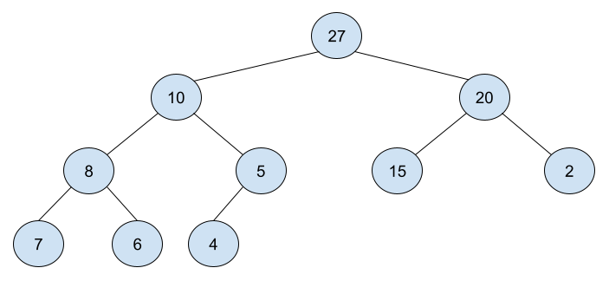
Meet Your New Friend: Binary Heap
As you can see, you already have a number of ways you could create this structure. Priority queues are interesting because there are some really cool approaches.
The approach shown here is the most common way to implement a priority queue in practice. The data structure is called a binary heap.
A binary heap is an "almost complete" binary tree in which every tree element "less than" (or equal to) (i.e., lower priority) than its parent.
In a complete tree all leaves have the depth. A binary heap is as "complete as it can be" with new entries filling in the bottom row, left to right.
Question: How does this differ from a Binary Search Tree?

Slide 23
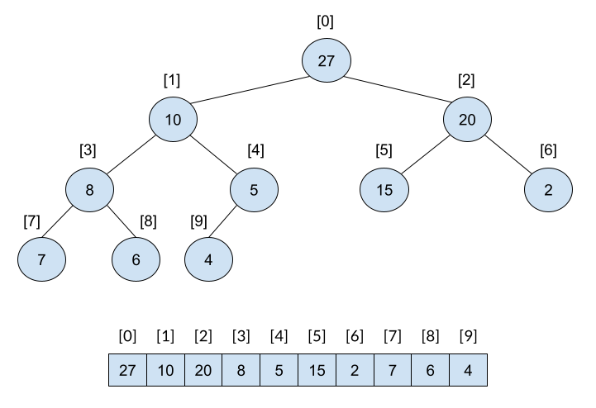
Array Representation of a Binary Heap
Because of their "almost complete" property there is an efficient way to represent a heap using an array. When we visualize the heap we draw it as a tree, but when we write the code we will store it as an array ...
Like this!
NOTE: Simply assign indexes from top, to bottom and left-to right on each row of the tree.
The array representation is concise and efficient.

Slide 24
Finding Parent, Left Child, Right Child in Array Representation
Exercise: Study this tree and its indexes and find a formula that, given an index of a node will identify the index of that node's left child.
Once you have a simple formula, create another formula for identifying the right child.
Finally, create a formula to find the parent.

Slide 25
Solution to Exercise
Solution:
left(pos) = 2 * pos + 1
right(pos) = 2 * (pos + 1)
parent(pos) = (pos -1) / 2
The parent formula assumes we are doing integer division where remainders are truncated.
Given these formulas we can now traverse the array as if it is a tree.

Slide 26
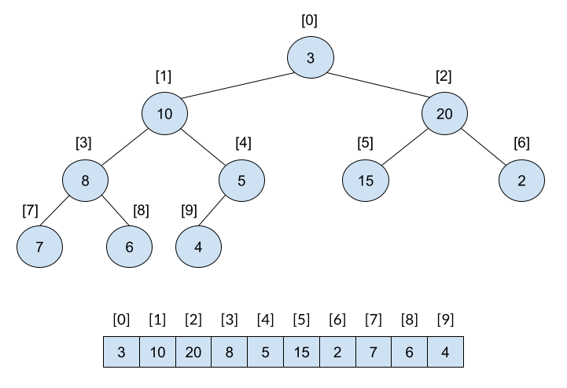
Heapify
Before we look at solutions for efficient inserting and removing elements from a heap in keeping with requirements of a priority queue let's discuss a helper operation that will be useful in a couple of contexts: heapify!
To apply the heapify operation we must have a special arrangement as depicted to the right. The root of the tree is out of place, but the remainder of the tree meets all the requirements of the heap.
The heapify action will modify a tree in this condition to be a heap.

Slide 27
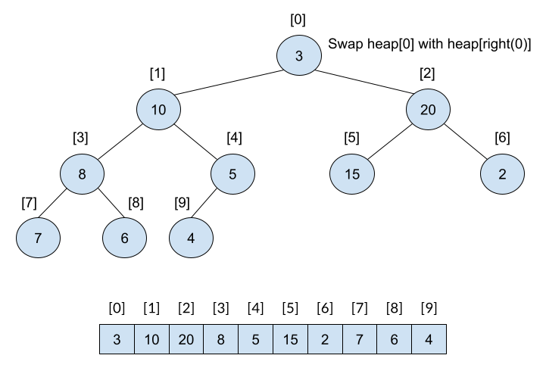
Heapify WalkThrough: Step 1
Heapify begins at the root (i.e, position 0 of the array). Let pos=0. We then compare the heap[pos] with heap[left(pos)] and heap[right(pos)].
If heap[pos] is the largest then we do nothing because the result must already be a heap.
If heap[left(pos)] is the largest we swap(heap[pos], heap[left(pos)]
If heap[rigft(pos)] is the largest we swap(heap[pos], heap[right(pos)]
In this example we swap heap[0] and heap[2].

Slide 28

Heapify WalkThrough: Step 2
After we swap the largest of the three values to the root, we recursively perform heapify on the newly swapped child ... in this example it was the right child at index 2 of the array.
Heapify continues as before. If the element at index 2 is bigger than both of its children we are done. Otherwise we swap with the largest of the children and heapify from that child.
In this case we swap heap[2] and heap[5] ...

Slide 29

Heapify WalkThrough: Step 3
After the most recent swap the element at index 2 has been put in the right spot and we heapify at index 5.
In this case the element at index 5 doesn't have any children and so by default we can stop heapifying.
Notice that the resulting tree is now a heap.

Slide 30
Complexity of Heapify
Exercise: Revisit the diagrams and come up with an accurate big-oh estimate for the heapify operation assuming the heap contains n nodes.
Here are some things to consider:
What is the height of the heap/tree?
What is the cost of a single compare and swap action?
How many compare and swap actions might you need to make in the worst case?
Solution:
The height of a binary heap is O(lg n) because the tree is completely balanced.
The cost of a single compare/swap is O(1)
In the worst case we may need to perform compare/swap actions from the top of the tree all the way to the bottom.
Complexity of heapify: O(lg n)

Slide 31
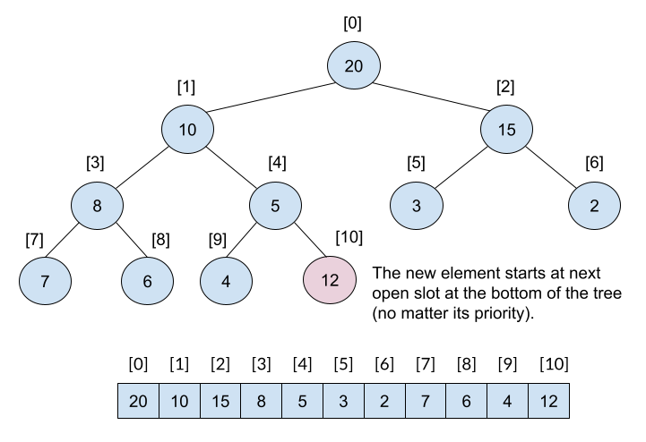
Heap Insert: Step 1
Heap insert is pretty simple:
We have to keep the tree balanced so we always insert at the "next" open slot at the bottom of the tree.
While that keeps the tree balanced we will likely violate the property require each node to be smaller than its parent.
So, we fix it by comparing the newly entered node (at index 10) in this case with its parent. If the parent is less than it then we swap them (which is necessary in this case).

Slide 32
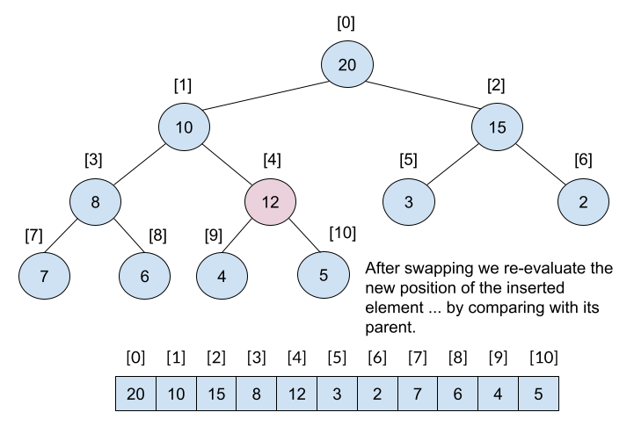
Heap Insert: Step 2
After the swap we will now compare our inserted element with its new parent and see if we are still violating the priority property.
In this case we are, so we have to swap the inserted element now at index 4 with its parent (index 1).

Slide 33

Heap Insert: Step 3
After the swap we will now compare our inserted element with its new parent and see if we are still violating the priority property.
In this case we are not because the new element (12) is less than its parent (20). So we stop.
Of course, if we had inserted a number bigger than the root the new element would have floated to the top of the heap and we would stop when there is not parent to compare it with.

Slide 34
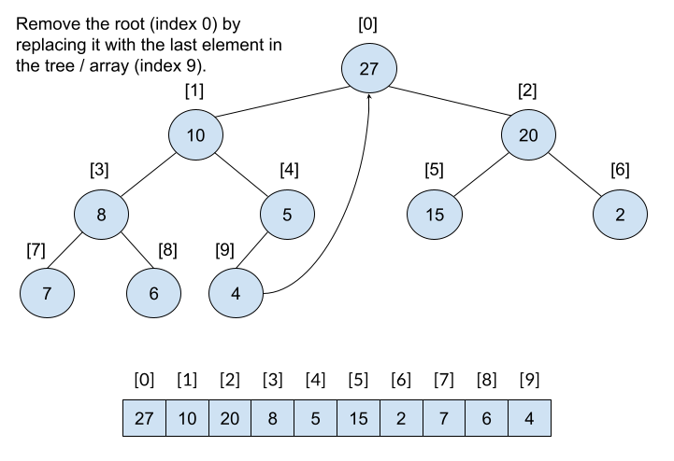
Heap Remove: Step 1
Since we are using the binary heap as a way to implement a priority queue, when we remove an element we will always be removing the one with highest priority.
Since it is a binary heap that highest priority element will always be at the root! And the root is a position 0 of the array. Easy to find!
However, we have to fix the heap after we remove the root. We will simply replace the root with the last element in the array/tree. Since it was at the bottom it is unlikely to be a good candidate.

Slide 35
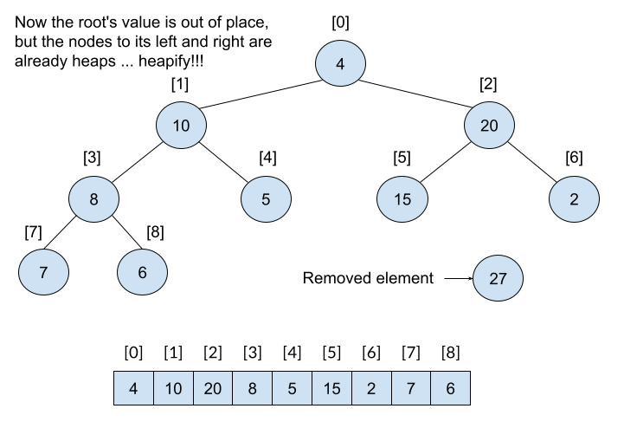
Heap Remove: Step 2
After replacing the root with the bottom entry our tree looks like this.
The root element is out of place, but the left and right subtrees are valid heaps. This is exactly the precondition needed for the heapify operation!
So we perform heapify(0).
Exercise: perform the heapify operation and verify you get the same result as the tree on the next slide.

Slide 36
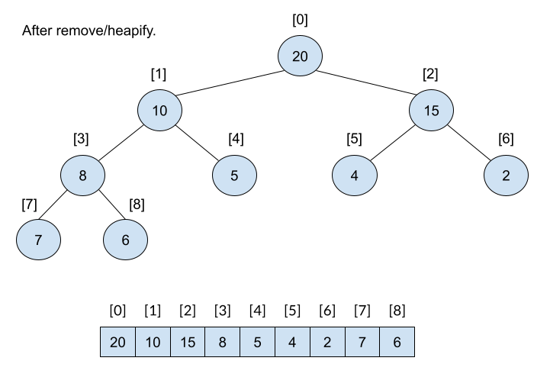
Heap Remove: Step 3
After heapifying our tree is now a heap again and looks like this.
Complexity of Heap Remove?
cost to find max: O(1)
cost to replace max with bottom element: O(1)
cost to heapify: O(lg n)
Total: O(lg n)

Slide 37
Why Binary Heaps for Priority Queues??
Some thoughts:
binary heaps allow us to insert and remove in a priority queue in O(lg n)
this was the same complexity we could have achieved using red-black trees
so why bother with binary heaps?
Answer: using a red-black tree to implement a priority queue is a little like killing fly with a sledge hammer! It is effective, by takes a lot more energy than necessary. Although both structures give us O(lg n), the binary heap has MUCH smaller constants and so is faster in practice.
More thoughts:
there is a kind of heap called a fibonacci heap that provides (using so-called "amortized analysis") insert and removal in O(1)
that's really cool and impressive!
so, why don't we use fibonacci heaps instead of binary heaps?
Yes, its true that fibonacci heaps are O(1) (amortized). But they have bigger constants than a binary heap so in practice you will not experience the benefit except for VERY large values of n.

Slide 38
BONUS: Java's Built-In PriorityQueue Class
Java provides a built-in PriorityQueue class.
See: https://docs.oracle.com/javase/10/docs/api/java/util/PriorityQueue.html
Whatever objects you are inserting into the priority must define .compareTo() (or utilize a comparator).
Easy peasy!
Exercise (left to reader): Write a Node class that will give Nodes with a larger count higher priority. Write the class so it will work with this program.
PriorityQueue<Node> q= new PriorityQueue<Node>();
Node x;
q.add(new Node("Fred",3));
q.add(new Node("Amy",6));
q.add(new Node("Sam",1));
q.add(new Node("Alice",10));
q.add(new Node("Mark",5));
q.add(new Node("Bobby",7));
while (q.size() > 0) {
x= q.remove();
System.out.println(x);
}

Slide 39
Traversing Graphs
For any structure we build one of the most common actions is to traverse the structure.
Traverse = visit every element in the structure.
In the case of a graph we want to visit all the vertices. The order in which we visit vertices is not obvious since in many graphs the number of possible paths to visit every node is exponential.
There are two widely used graph traversal techniques:
Depth-first search (DFS) - from the starting vertex we traverse as far into the graph as possible, backing up only when necessary
Breadth-first search (BFS) - from the starting vertex we first visit those vertices that are adjacent (i.e., one step away) ... and the we visit those vertices that are two steps away ... and then three steps away, etc.

Slide 40
Pseudocode for DFS and BFS
DepthFirstSearch(startVertex)
put startVertex on a stack
mark startVertex as visited
while (stack is not empty) do
curr = remove elem from stack
process curr
for each unvisited neighbor of curr do
put neighbor of curr onto the stack
mark neighbor as visited
endfor
endwhile
BreadthFirstSearch(startVertex)
put startVertex on a queue
mark startVertex as visited
while (queue is not empty) do
curr = remove elem from queue
process curr
for each unvisited neighbor of curr do
put neighbor of curr onto the queue
mark neighbor as visited
endfor
endwhile

Slide 41
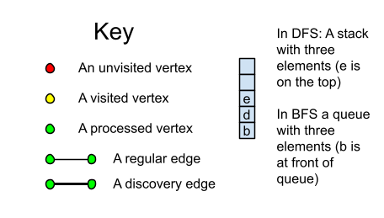
Tracing DFS
In order to trace a DFS in a graph we keep track of:
The state of the stack
Which nodes have been visited
Which nodes have been processed
The order in which nodes have been processed
The edges from which each node was discovered

Slide 42
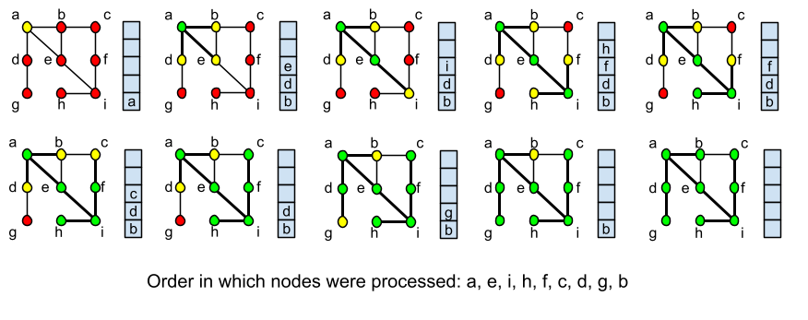
DFS Example

Slide 43
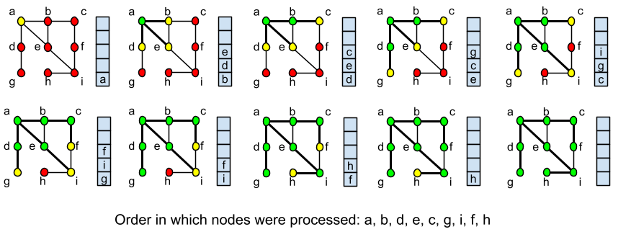
BFS Example

Slide 44
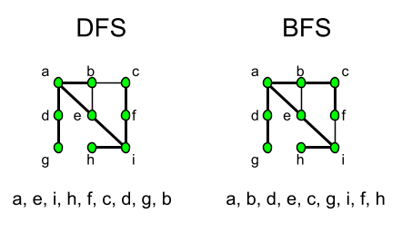
Contrasting DFS and BFS
Consider the completed DFS/BFS graphs which show the order in which nodes were processed and the discovery paths.
DFS - Goes a-e-i-h as its initial path (getting further and further away from the start vertex ... until it reaches a dead end). Then it backtracks as little as possible (to f) and continues its deep dive from there.
BFS - Goes a-b-d-e (all of which are adjacent to the start vertex) and then expands to c-g-i (all of which are two steps away from the start), and the finally to f-h (three steps away from start).
Exercise: Create a graph with 9 or 10 vertices and then perform a DFS and BFS search. Compare the results and observe their differing behaviors.

Slide 45
Complexity of DFS and BFS
DFS and BFS have same complexity because they work in the same way except for stack vs. queue. Recall that stack/queue insert/remove are O(1).
Notation:
|V| = number of vertices in graph
|E| = number of edges in graph
The while loop happens |V| times
The for loop is hard to imagine because we go over a few edges each time ... but over the course of the entire algorithm we consider every edge! (|E| edges)
Total complexity: O(|V| + |E|)
DepthFirstSearch(startVertex)
put startVertex on a stack
mark startVertex as visited
while (stack is not empty) do
curr = remove elem from stack
process curr
for each unvisited neighbor of curr do
put neighbor of curr onto the stack
mark neighbor as visited
endfor
endwhile

Slide 46
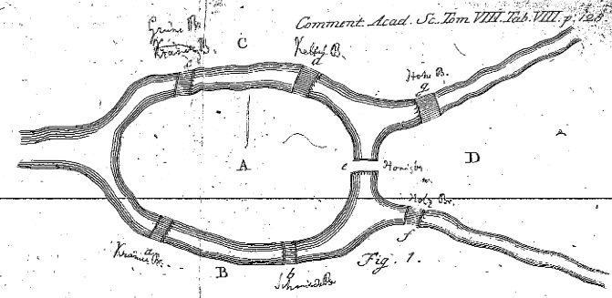
The Konigsberg Bridge Problem
Consider the image to the right which depicts four land masses (A, B, C, and D) at the confluence to two rivers. There are seven bridges across the rivers connecting various land masses.
Goal: Find a path in which each bridge is crossed exactly once (i.e., every bridge is crossed and no bridge is cross twice). You can start on any land mass and end on any land mass.
Exercise: Take 5 minutes or so to come up with your chosen path to solve this problem.
Image is compliments of: https://www.maa.org/press/periodicals/convergence/leonard-eulers-solution-to-the-konigsberg-bridge-problem

Slide 47
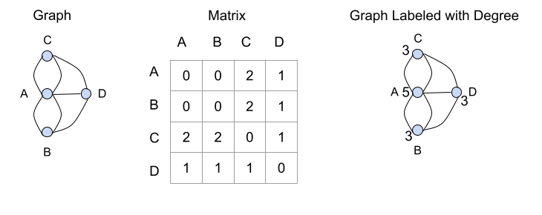
Solution to Konigsberg Bridge Problem
To think about this problem we can consider several representations of it as depicted to the right.
Graph - Removes extraneous details and allows us to focus on the problem without distraction.
Matrix - Shows connections in systematic way
Degree Labels - Turns out to yield useful information for this particular problem.
Solution path:

Slide 48
Euler Paths / Cycles (Pronounced Oiler)
On the previous slide we left the solution path blank because there is no solution for the given graph!
This problem (i.e., visit every edge in a graph exactly once) is named for a mathematician (Euler).
An Euler Path is a path through a graph in which every edge is crossed exactly once.
An Euler Cycle is a cycle in a graph in which every edge is crossed exactly once.
Euler proved the following theorem:
A (connected) graph has an Euler path if and only if there are no vertices with odd degree or there are exactly two vertices with odd degree.
Exercise: Write down answers to these questions:
What is the difference between "if" and "if and only if"?
Do you see why this theorem proves that a solution to the Konigsberg Bridge Problem doesn't exist?
What about graphs in which only one of the vertices have odd degree? (HINT: Draw such a graph and experiment with it).

Slide 49
Euler Paths / Cycles (Solution to Exercise)
What is the difference between "if" and "if and only if"?
The statement: "I take an umbrella to work if and only if it is raining when I leave the house," means:
if I take an umbrella to work it is raining when I leave the house AND
if it is raining when I leave the house I take an umbrella to work
That is different than merely saying: "if it is raining when I leave the house then I take an umbrella with me." (because in this case I may take my umbrella to work even if it is not raining when I leave the house)
Do you see why this theorem proves that a solution to the Konigsberg Bridge Problem doesn't exist?
The Konigsberg graph has 4 vertices with odd degree therefore it does not have an Euler Path.
What about graphs in which only one of the vertices have odd degree? (HINT: Draw such a graph and experiment with it).
It is not possible to create a graph in which only one vertex has odd degree.

Slide 50
Theorem for Euler Cycle
Recall the theorem regarding the existence of an Euler path:
A (connected) graph has an Euler path if and only if there are no vertices with odd degree or there are exactly two vertices with odd degree.
Interestingly, if the graph has two vertices of odd degree then the path will have to start at one of them and end at the other!
There is a similar theorem related to the existence of an Euler Cycle:
A (connected) graph has an Euler cycle if and only if there are no vertices with odd degree
NOTE: Cost to determine whether a cycle/path exists ... you must calculate degree of every vertex. Assuming you have an adjacency list representation this can be done in O(|V| + |E|)

Slide 51
Hamiltonian Cycles
A Hamiltonian Cycle in a (connected) graph is a cycle in which every vertex is visited exactly once (except the starting vertex which is visited a second time in the last step of the cycle).
Although this problem has a very similar feel to that of an Euler cycle it has surprising different results.
In particular there is no known efficient method for identifying whether such a cycle exists.
In the worst case, the best known algorithms to solve this problem are exponential in complexity!
Theorem: In a graph G with n vertices where n >= 3, G has a Hamiltonian circuit if the degree of each vertex is at least n/2.
Question: How does this theorem line up with the claim just made about there being no fast/simple mechanism for determining whether a Hamiltonian path exists?

Slide 52
The Muddy City Problem aka Minimal Spanning Trees
Take ten minutes or so to jot down your answer to the following activity:
https://josephus.hsutx.edu/classes/ds/source/muddy_city.pdf
Jot down the cost of your final solution.
Some things to notice about this problem:
The goal was not to create a shortest path or to make getting around the town efficient.
The goal was to minimize the amount of paving that had to be done.
This particular problem is an instance of a classic concept in graph theory: a minimal spanning tree.
A spanning tree of a connected graph is a tree in which connects all vertices of the graph using some subset of edges from the original graph.
Given a connected graph with weighted edges, a minimal spanning tree (MST) is a spanning tree whose sum of edge weights is as small as possible.

Slide 53
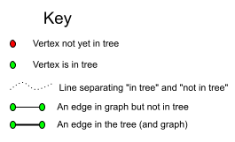
Prim's MST Algorithm
The following algorithm is attributed to Prim:
let w[i][j] = weight of edge from vertex i to j
for each vertex set priority= infinity and prev value = null
let S = priority queue of vertices not included in tree (yet)
let x = start vertex (and set its priority to 0)
for each elem of V
insert elem into S
endfor
while S != {} do
curr = remove smallest cost vertex from S
for each neighbor of curr do
if neighbor is in S and w[curr][neighbor] < neighbor
neighbor.priority= w[curr][neighbor]
neighbor.prev= curr
endif
endfor
endwhile
When tracing this algorithm by hand we typically use a dotted line to separate vertices which have been included in the tree from those which are not yet in the tree.

Slide 54
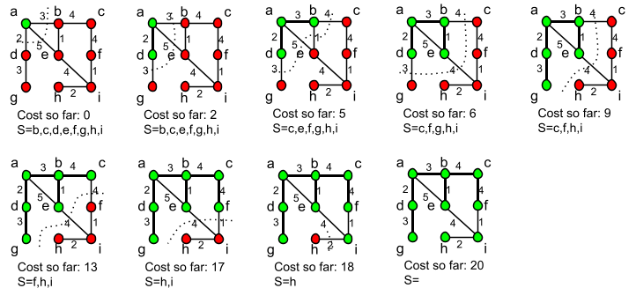
Tracing Prim's Algorithm
NOTE: The bolded lines represent the edges included in the MST.

Slide 55
Prim's Exercise
Exercise:
Represent the "Muddy City" problem as a graph and then trace Prim's algorithm.
Redraw the graph at each step and draw the line separating the elements in the tree from those not in the tree.
Calculate the cost of the MST as determined by this algorithm.
How does the cost compared to the solution you found manually?

Slide 56
Analyzing the Complexity of Prim's Algorithm
An efficient solution to Prim's algorithm requires several structures:
a weighted adjacency matrix in which edge weights are given (given)
an adjacency list from which we can efficiently find adjacent vertices (given)
a priority queue in which edges with smallest "priority value" rise to the top
// Before the main while loop
let w[i][j] = weight of edge from vertex i to j
for each vertex set priority= infinity and prev value = null
let S = priority queue of vertices not included in tree (yet)
let x = start vertex (and set its priority to 0)
for each elem of V
insert elem into S
endfor
adjacency matrix and list (given)
setting priority and prev of each vertex: O(|V|)
dealing with start node: O(1)
adding vertices to PQ: O(|V| lg |V|)
Total: O(|V| lg |V|)

Slide 57
Complexity of Prim's (continued)
// the main loop
while S != {} do
curr = remove smallest cost vertex from S
for each neighbor of curr do
if neighbor is in S and w[curr][neighbor] < neighbor
neighbor.priority= w[curr][neighbor]
neighbor.prev= curr
endif
endfor
endwhile
For each vertex (|V| times through while).
Remove from S (lg |V|)
Visiting each neighbor (throughout the course of the entire while loop this will amount to |E| actions
Inside the for loop we have to update priority (which requires rearranging its location in the priority queue .... O(lg |V|)
So:
while loop: O(|V| lg |V|)
for loop: O(|E| lg |V|)
before the while: O(|V| lg |V|)
Total: O(|V| lg |V| + |E| lg |V|)
Also written as: O((|V| + |E|) lg |V|)

Slide 58
Summary of Sorting Methods
Time required for various sorting techniques to sort 2,000,000 Person objects (by an integer amount). The data set and size was an ideal candidate for counting sort.
The "Fancy Quicksort" used median-of-3 for selecting its partition element and also utilized a selection sort for partitions that had fewer than 8 elements.
The "Fancy Mergesort" used a selection sort for partitions that had fewer than 8 elements.
Java Built-In | 1.27 seconds
Counting Sort | 0.11 seconds
Quicksort | 0.67 seconds
Fancy Quicksort | 0.58 seconds
Mergesort | 1.04 seconds
Fancy Mergesort | 1.05 seconds
Heapsort | 1.98 seconds

Slide 59
Intro to binary, bits, etc.
Java provides several operators for the purpose of performing bit-wise operations on integer data types (long, int, char, etc.)
What's a "bit"?
Digital computers represent all data in binary (i.e., 0's and 1's)
A bit is a single "binary digit" (0 or 1)
In Java a variable of type "int" is represented as 32 bits
It can be useful/efficient to understand this binary representation and to manipulate individual bits of that representation.
Consider these declarations in Java:
byte x, y, z;
x= 27; // In binary: 00011011
y = 37; // In binary: 00100101
z = -27; // In binary: 11100101
The "byte" data type in Java is a signed integer that can hold 8 bits. Because of its small size it can only represent numbers in the range -128 to 127. We use it in examples here so we don't have to keep track of 32 or 64 bits!
Negative numbers are stored using "two's complement" ... leftmost bit will be a 1 for negatives

Slide 60
Java Bitwise & (and)
We use bitwise operators to manipulate individual bits in an integer data type. Consider the bitwise operator & (and).
byte x, y, z;
x= 27; // In binary: 00011011
y= 37; // In binary: 00100101
z= x & y; // In binary: 00000001
If you line up the individual bits in x and y and then perform an "and" operations (both bits must be a 1 to yield a 1, otherwise the result is 0), then x&y yields: 00000001.
What's the difference between & and &&?
Notationally this looks similar to the boolean operator && that we use in if-statements.
& ==> performs a bitwise action on integer data and produces an integer result
&& ==> performs a logical action on boolean data and produces a boolean result

Slide 61
Java's Bitwise Operators
Here's a list:
& --> bitwise and
| --> bitwise or
^ --> bitwise exclusive or
~ --> bitwise complement (not)
<< --> left shift
>> --> right shift (arithmetic)
>>> --> right shift (logical)
byte x, y, z, a, b, c;
x= 27; // In binary: 00011011
y = 37; // In binary: 00100101
z = -27; // In binary: 11100101
a= x & y; // & means "both"
// x: 00011011
// y: 00100101
// a: 00000001
a= x | y; // | means "either or both"
// x: 00011011
// y: 00100101
// a: 00111111
a= x ^ y; // ^ means "either but not both"
// x: 00011011
// y: 00100101
// a: 00111110

Slide 62
More Examples of Bitwise Operators
a= x << 1; // shift the bits in x left by 1
b= x << 2; // shift the bits in x left by 2
// x: 00011011
// a: 00110110 ... fill in with 0's
// b: 01101100
a= x >> 1; // shift the bits in x right by 1
b= x >> 2; // shift the bits in x right by 2
c= z >> 1; // shift the bits in z right by 1
// x: 00011011
// a: 00001101 ... fill in with leftmost bit
// b: 00000110
// z: 11100101
// c: 11110010
a= x >>> 1; // shift the bits in x right by 1
c= z >>> 1; // shift the bits in z right by 1
// x: 00011011
// a: 00001101 ... fill in with 0's
// z: 11100101
// c: 01110010
a= ~x; // flip all the bits in x
// x: 00011011
// a: 11100100

Slide 63
Common Uses of Bitwise Operators
Great ... so we can flip bits using these operators ... who cares / why?
Dividing (integer) by 2 or multiplying by 2.
Consider base-10: Shift the number 52 to the left -> 520 (i.e., we multiplied by the base)
If we shift 520 to the left by 2 we multiply by the base twice (i.e., 100) -> 5200.
In base-10 if we take 52352 and shift right by 1 we get 5235 (i.e., divided by 10).
When working with bits (binary) we can shift to divide or multiply by 2.
For working with signed ints be sure to use the arithmetic shift
Efficiently Checking for Even / Odd
If you apply & to the number 1 and an integer the result will be zero if that integer is even and 1 if odd.
This is slightly more efficient that using %
e.g., if ((x & 1) == 0) // its even

Slide 64
Common Uses of Bitwise Operators (continued)
Performing a Swap!
This is a cool trick that allows you to swap two integers without the need for a temporary variable!
Suppose x and y are holding integers ... Just do this:
x= x^y;
y= y^x;
x= x^y;
Yes, this is kind of cool ... but obscure.
The basic idea behind why this works is that xoring a value twice will produce the original value ... so by the end of the second xor, y has been properly set and by the third xor, x has been properly set.
Representing and Manipulating Sets
long a; // a is a 64-bit integer
Suppose "a" holds this (in binary): 000...0101101
This would represent a set that contains elements 0, 2, 3, and 5 (because the bits at position 0, 2, 3, and 5 ... from right to left ... are set to 1). And this set would not contain elements 1, 4, 6, 7, ... , 63.

Slide 65
More About Representing Sets
To understand why we might want to represent set membership using bitwise operators, take a moment to consider how you might accomplish the same thing using a different technique.
Perhaps:
an array boolean values?
a linked list of integer data with each node holding the number of the set element that is in the set?
Consider, using these approaches how you would perform:
clearing a set
union of two sets
intersection of two sets
difference of two sets
adding an element to a set
deleting an element from a set
checking to see if an element is a member of a set ...
(LOTS OF LOOPS!)

Slide 66
Using a Bit String to Represent a Set (Clear, Union, Add)
long a, b, c; // a,b,c are 64-bit integers
To clear (empty) a set we simply fill with 0's:
a= 0;
To perform the union of two sets (c = a UNION b) we simply perform a bit-wise OR:
c= a | b;
To add an element to an existing set (add element 22 to the set "a") we first create a simple set containing only the element 22. Then we perform a union with "a" and the simple set we just created:
b= 1 << 22; // 0000...01 shifted left 22
a= a | b; // add 22 to a

Slide 67
Using a Bit String to Represent a Set (Exercises)
Exercises:
Write a Java program that will create two sets (a and b):
Write commands that will put elements 1, 3, 4, 5, 8, 12, 22 into the set a.
Write commands that will put elements 2, 3, 6, 8, 10, 12 into set b.
Write a command to do this: c = a INTERSECTION b
Write commands to perform: remove element 22 from the set "a".
How will you know if your commands work?
Hints for exercises:
HINT: Steps 1 and 2 are simply repeating information from the previous slide.
HINT: Step 3 is easy.
HINT: Step 4 requires combining a couple of ideas
think about how we added 22 to the set
to remove we need to create a bit string that looks like this: 111...1011...1 (ie., it has 1's everywhere except for a 0 in slot 22. (I used complement as part of this step)
then use intersection

Slide 68
Using a Bit String to Represent a Set (Solution to Exercises)
// I wrote a helper function ...
public static long add(long set, long elem) {
return set | (1 << elem);
}
// clear a and b
long a= 0, b= 0, c;
// add 1,3,4,5,8,12,22 to a
a= add(a,1);
a= add(a,3);
a= add(a,4);
a= add(a,5);
a= add(a,8);
a= add(a,12);
a= add(a,22);
// do same kind of stuff for b (omitted)
// c = a INTERSECTION b
c= a & b;
// remove 22 from a:
// 1 << 22 = 00000000100000 (1 is in slot 22)
// ~(1<<22) = 11111111011111 (0 is in slot 22)
c= ~(1 << 22);
a= a & c;
// Ideas for testing: print a and b
// Use decimal to binary converter to check

Slide 69
Using a Bit String to Represent a Set (Set Membership)
Suppose we want to find out whether a particular element is a member of the set "a". In this case, instead of assuming a hard-coded value (say 22), we will assume we have an integer "n" that holds the number we want to look for.
b= 1L << n;
if ((a & b) == 0) {
System.out.println(n + " is NOT in the set!");
}
else {
System.out.println(n + " is in the set!");
}

Slide 70
One More Exercise with Bit Strings
Exercise:
Write a Java method called displaySet that accepts a set (of type long) as a parameter and will print out the numbers of the elements in the set.
HINT: You can start with 1 and keep shifting left by 1 checking for membership ... OR ... you can shift the set elements to the right looking at the least significant position and keep a counter.
Solution(s):
public static void displaySet(long set) {
for (int i=0; i<64; i++) {
if ((set & (1L << i)) != 0) {
System.out.println(i);
}
}
}
public static void displaySet2(long set) {
int n= 0;
do {
if ((set & 1)!= 0) {
System.out.println(n);
}
set= set >>> 1;
n++;
} while (set != 0);
}

